Slide 1
RNA Seq:
A (soon to be outdated) Tutorial

Slide 2

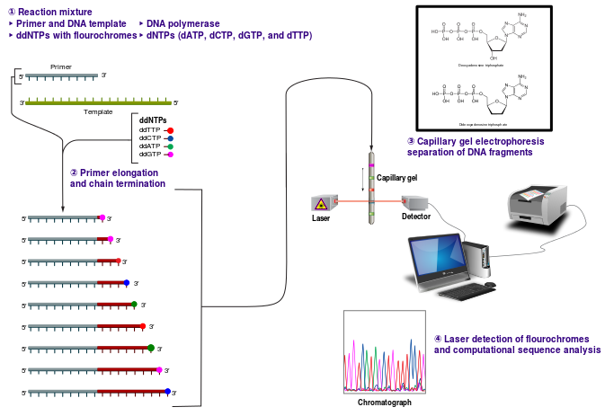
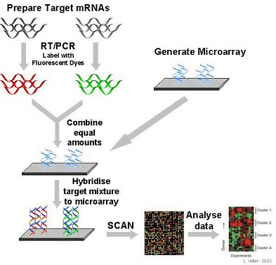
A Brief History of Sequencing and Gene Expression
Tag Based Sequencing Approaches
Serial Analysis of Gene Expression (SAGE)
Cap Analysis of Gene Expression (CAGE)
Massively parallel signature sequence (MPSS)
Frederick “Fred” Sanger
Hybridization Based Gene Expression Quantification
Reliance on existing knowledge about genome sequence
High background due to cross-hybridization
Requires lots of starting material
Limited dynamic range of detection
Limitations of Sanger Sequencing
Low throughput
Inconsistent base quality
Expensive
Not quantitative
Notes:
Sanger Method: chain termination method using labelled dideoxyNTPs; process can be automated (24 X 384 samples); poor quality. Approach used to annotate human genome and establish EST/cDNA libraries. SAGE, CAGE MPSS all use Sanger method

Slide 3


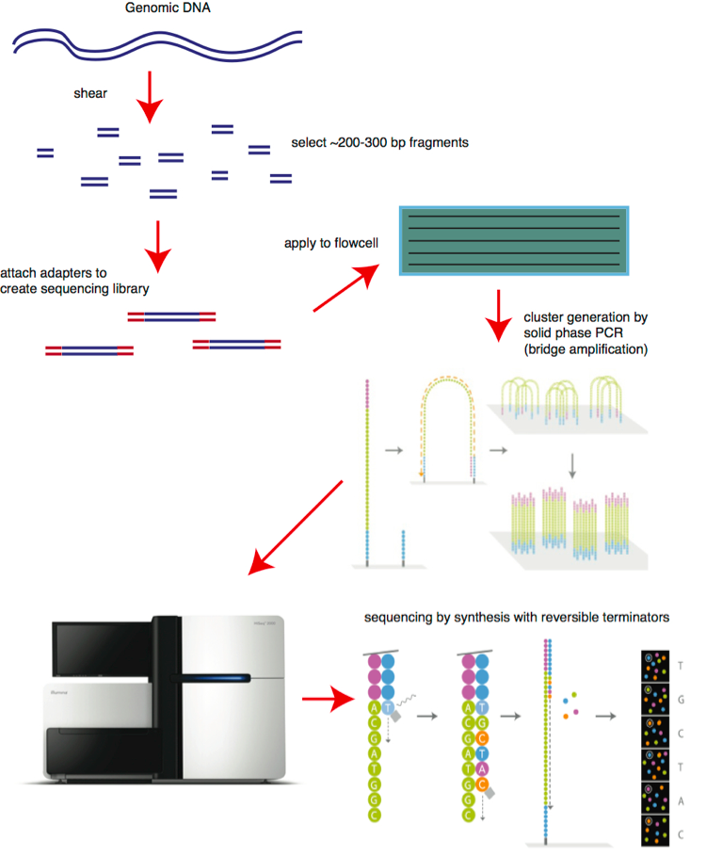
Next Generation Sequencing
(Massive Parallel Sequencing)
Principles
Fragmentation and tagging of genomic/cDNA fragments – provides universal primer allowing complex genomes to be amplified with common PCR primers
Template immobilization – DNA separated into single strands and captured onto beads (1 DNA molecule/bead)
Clonal Amplification – Solid Phase Amplification
Sequencing and Imaging – Cyclic reversible termination (CRT) reaction
Notes:
Sangar (capillary sequencing) invented in 1977, lasted for 25 years. SPRI beads: paramagnetic beads (polysterene coated in magentite, carboxyl molecules) – promotes reversible binding of DNA in the presence of PEG (20%) and salt (2.5M NaCl)

Slide 4
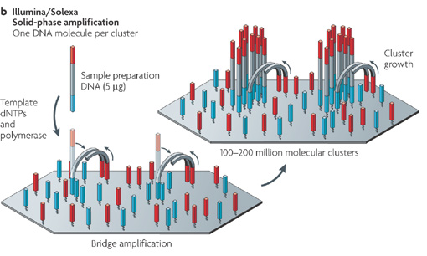
Next Generation Sequencing
(Massive Parallel Sequencing)
Clonal Amplification – Solid Phase Amplification
Priming and extension of single strand, single molecule template; bridge amplification of the immobilized template with immediately primers to form clusters (creates 100-200 million spatially separated template clusters) providing free ends to which a universal sequencing primer can be hybridized to initiate NGS reaction – each cluster represents a population of identical templates

Slide 5
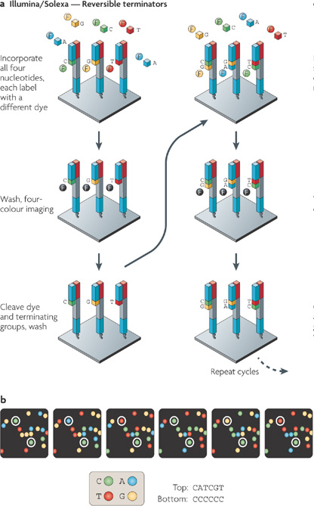
Next Generation Sequencing
(Massive Parallel Sequencing)
Cyclic Reversible Termination – DNA Polymerase bound to primed template adds 1 (of 4) fluorescently modified nucleotide. 3’ terminator group prevents additional nucleotide incorporation.
Following incorporation, remaining unincorporated nucleotides are washed away. Imaging is performed to determine the identity of the incorporated nucleotide.
Cleavage step then removes terminating group and the fluorescent dye. Additional wash is performed before starting next incorporation step
This is repeated ~250 million times (25Gb) with HiSeq2500 (~4 days)
Unlike SANGER termination is REVERSIBLE
Notes:
3’O-azidomethyl reversible terminator; reducing agent with TERP; Slide of immobilized template partitioned into 8 channels (8 lanes) method susceptible to substitutions especially when preceding base is G; amplification bias from SPA
Pacific Bioscencies – zero mode waveguide – allows for real time monitoring of incorporation of dye labelled nucleotides without stopping reaction.

Slide 6
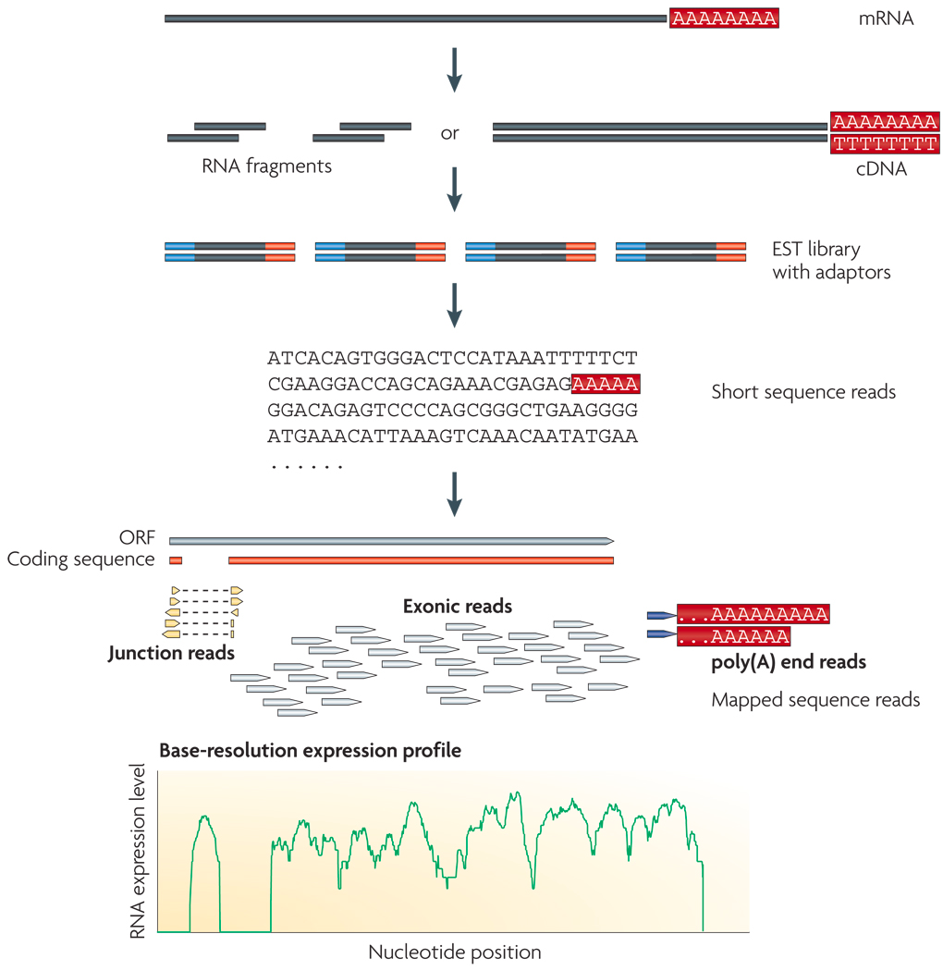
RNA Sequencing
Population of RNA (poly A+) converted to a library of cDNA fragments with adaptors attached to one or both ends
Solid Phase Amplification performed
Molecules sequenced from one end (Single End) or both ends (Pair End)
Reads are typically 30-400bp depending on sequence technology used

Slide 7
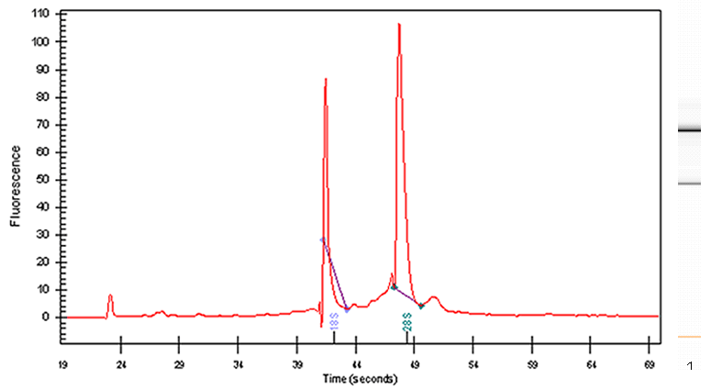
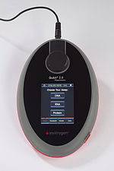
RNA Purification and Analysis
RNA Purification: Can use Qiagen Kit or Phenol/Chloroform Extraction, do not use Invitrogen RNA isolation kit
RNA Quality Assessment (Agilent 2100 BioAnalyzer)
RNA Quantification (Qubit) – nanodrop considered too inaccurate
Bioanalyzer analysis can be done at Clinical Microarray Core
clientserviceUIC@mednet.ucla.edu
Qubit Analyses can be done at
Stem Cell Core (Suhua Feng)
Sfeng@mednet.ucla.edu

Slide 8
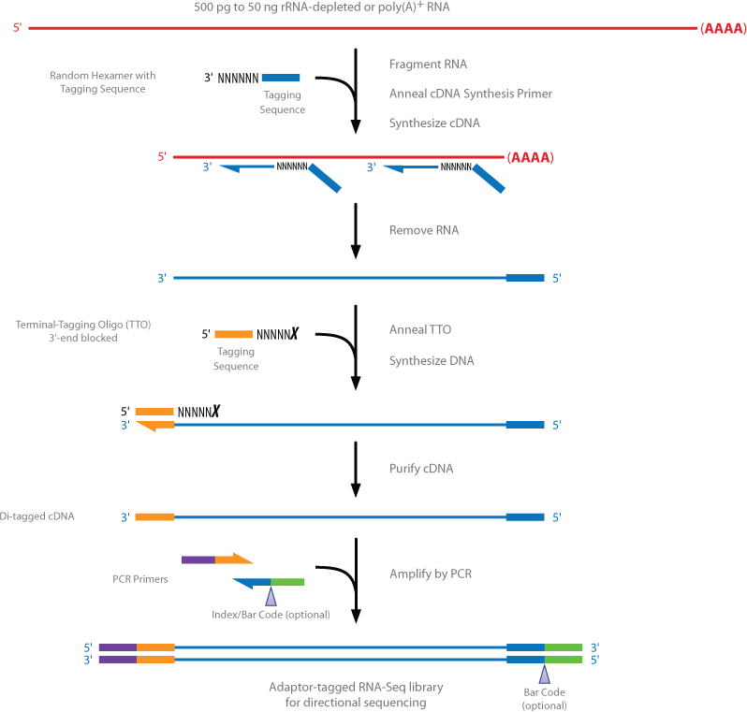
TRUSEQ Library Preparation
Library Construction
Effective elimination of ribosomal RNA (negative selection) followed by polyA selection (for mRNA)
High Quality Strand Information
Can be used with low quality/low abundance RNA (10-100ng)
48 barcodes allows for multiplexing
Small RNAs can be directly sequenced
Large RNAs must be fragmented
Library Construction can be done at cost at Gonda Genomics Core
$1300/8 samples
Joseph deYoung
jdeyoung@mednet.ucla.edu
http://res.illumina.com/documents/products/datasheets/datasheet_truseq_stranded_rna.pdf

Slide 9
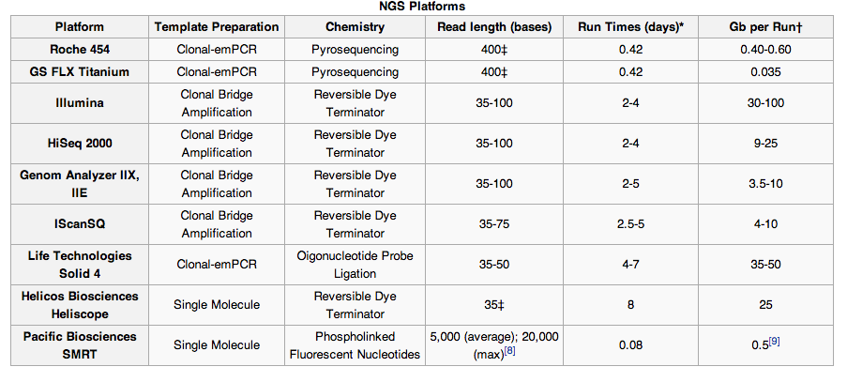
Sequencing Apparatus
HiSeq 2500 available on UCLA campus (all high usage)
Gonda (1 machine)
Joseph DeYoung
jdeyoung@mednet.ucla.edu
Clinical Pathology(2 machine)
Broad Stem Cell Core (3 machines)
Suhua Feng
sfeng@mednet.ucla.edu

Slide 10
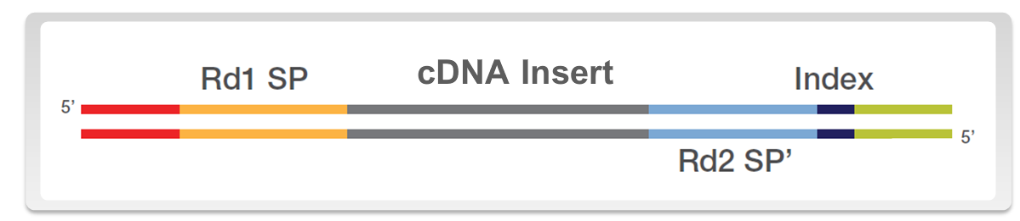
Experimental Design: Single End (SR) vs Paired End (PE)
Single Read: one read sequenced from one end of each sample cDNA insert
(Rd1 SP: Read 1 Seqeuncing Primer)
Paired End: two reads (one from each end) sequenced from each sample cDNA insert (Rd1 and Rd2 sequencing primer)
SR: often used for expression studies or SNP detection; NOT good for splice isoforms
PE: used for discovery of novel transcripts, splice isoforms and for de novo transcriptome assembly

Slide 11
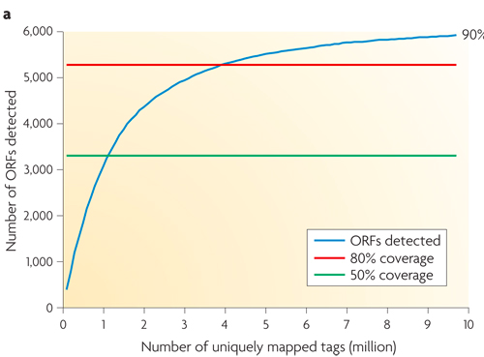
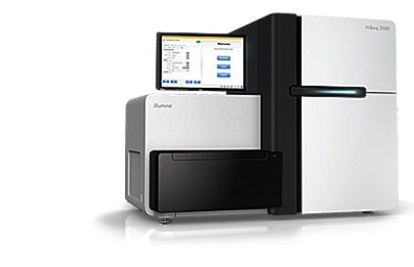
Experimental Design: How many reads do I need
Greater Sequencing Depth correlates with better genomic coverage and more robust differential gene expression analysis
Study Type Reads Needed
Expression Profiling 5-10 Million
Alternative splicing, quantifying cSNPs 50-100 M
De Novo Transcriptome Assembly 100-1000 M
Sequencing Instrument Reads per Lane (SR:PE) Reads per Flow Cell
HiSEQ 2500 185:375M 1.5:3 Billion

Slide 12
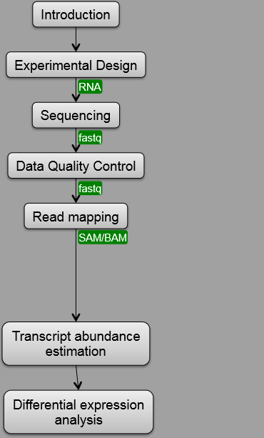
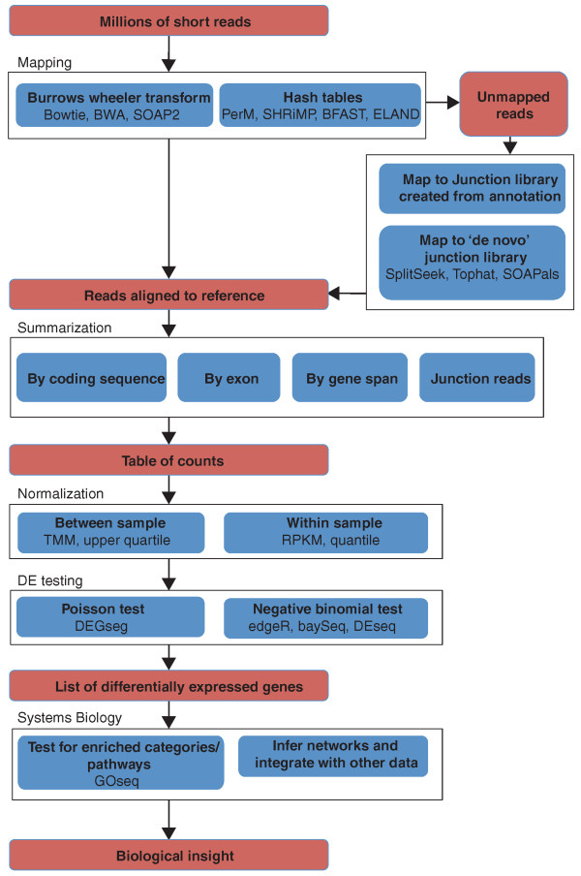
Sequence Analysis
Theory
Practice

Slide 13
Sequence Analysis
One flow cell can generate up to 600Gb of data. Where am I going to store this data?
Stem Cell Core will keep raw data for up to 6 months
Sequencing analyses takes a ton of processing power: Currently the Cheng Lab is insufficiently capable of storage, processing and expertise. While analyses programs have become more user friendly (i.e.Galaxy), storage and processing capability will always be required.
Hoffman2 Cluster: 11, 000 processors, 1300 active users using up to 8 million computing hrs per month.
A typical user account allows 20GB of permanent storage. Users are also provided a scratch folder (~100GB) where you can store files for up to 7 days at which point they are deleted permanently.
Access to the Hoffman2 cluster requires ucla email account (email Shirley Goldstein cusgsjn@ucla.edu)
However access also requires a PI sponser. Genhong is currently not.
Hoffman2 also provides computing tutorials on a regular basis (See website)
http://ccn.ucla.edu/wiki/index.php/Hoffman2:Getting_an_Account

Slide 14
Converting RAW data to FASTQ
SxaQSEQsXA050L3:xG3KF4Ue
RAW data from HISEQ 2500 run yields two files
.bcl file: contains base identity information for each run
.stats file: contains base intensity and quality information
Most (and probably all) programs need a merged file (named FASTQ or QSEQ)
Download and install bclconverter (already installed on Optiplex 990)
COMMAND
~bin/setupBclToQseq.py -i FOLDER_CONTAINING_LANE_DIRS -p POSITION_DIR -o OUT_DIR --overwrite
followed by make in OUT_DIR
If multiplexed, files then need to be de-multiplexed (this is slightly complicated)

Slide 15
Converting RAW data to FASTQ
FASTQ File
INSTRUMENT NAME
Tile #
ADAPTOR INDEX
X
Y
SINGLE END READ
Lane #
@SN971:3:2304:20.80:100.00#0/1
NAAATTTCACATTGCGTTGGGAACAGTTGGCCCAAACTCAGGTTGCAGTAACTGTCACAATACCATTCTCCATCAACTTCAAGAAATGTTCAACAAAACAC
+
@P\cceeegggggiihhiiiiiiihighiiiiiiiiiiiiiifghhhhgfghiifihihfhhiiiihiggggggeeeeeeddcdddccbcdddcccccccc
Line 1: begins with ‘@’ followed by sequence identifier
Line 2: raw sequence
Line 3: +
Line 4: base quality values for sequence in Line 2

Slide 16
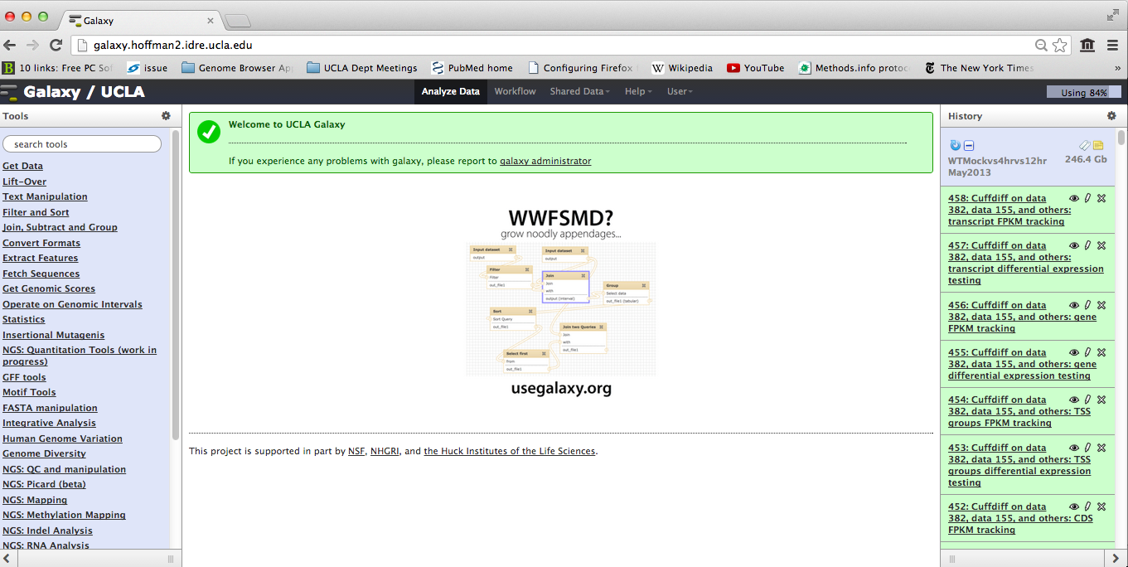
GALAXY
Published workflows
Video tutorials
User friendly web interface for processing and analyzing Sequencing Data
Galaxy has also been installed on the Optiplex 990
Allows for application of workflows – enable automated processing and mapping of data
Can add tools to the galaxy toolbox
Obtain a Galaxy account linked to the hoffman2 cluster for higher processing power – email Weihong Yan (wyan@chem.ucla.edu)

Slide 17
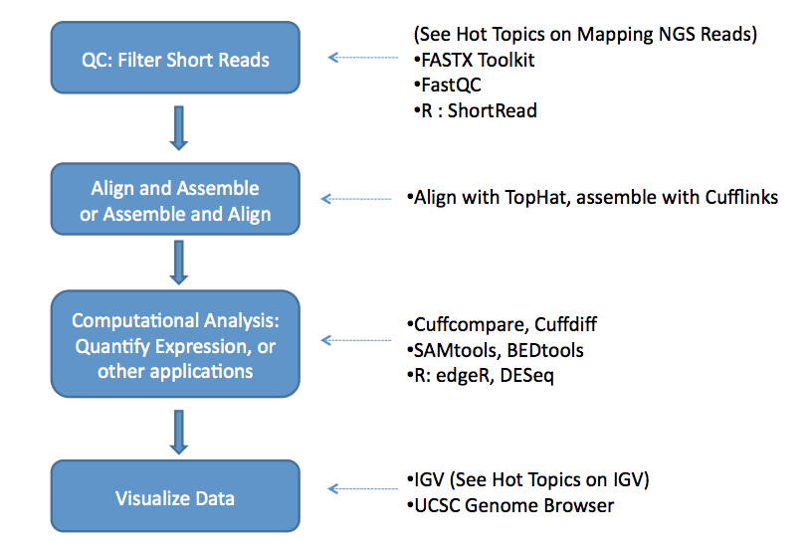
My RNA Seq Workflow
Work in progress

Slide 18
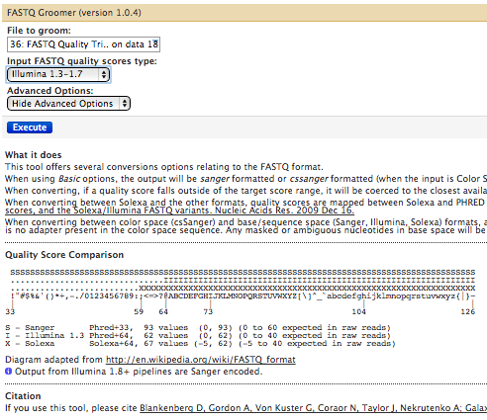
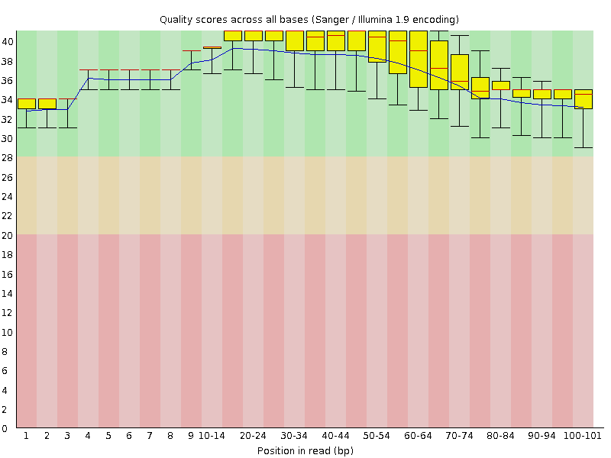
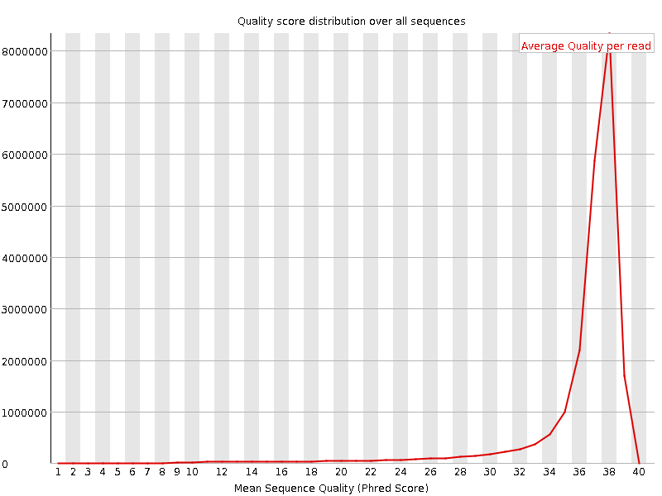
Quality Control
FASTQ Groomer: converts FASTQ data from different sources
(ie Illumina, 454 Sequence etc) to a consensus FASTQ file
FASTQ QC: assesses base quality of sequence reads
Per base sequence quality
per sequence quality scores
GC content
Sequence Length
Sequence Duplication
Overrepresented sequences
Kmer content
FASTQ TRIMMER: eliminate sequences below phRed score (usually <20)
Remember to check how many reads are lost from original input after processing
Quality
Genhong
Shankar
Kislay
Notes:
Phred 50 99.999, 40 (99.99) 30 (99.9)

Slide 19
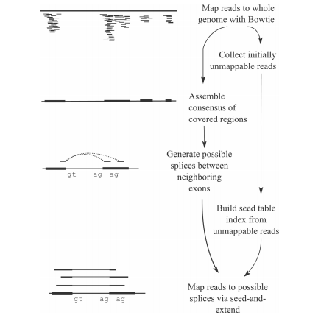
Reference Mapping - TOPHAT
INPUT
FASTQ (processed)
Output (4 files)
Insertions (.bed)
Deletions (.bed)
Junctions (.bed)
Accepted Hits (.bam)
TOPHAT provides both identifying and quantifying information
.bed files can be downloaded to excel
-sam (Sequence Aligment/Map) or bam (binary compressed version of sam) – can be used to visualize reads using UCSC Genome Browser or Integrative Genomics Viewer
Link to File type descriptions
https://genome.ucsc.edu/FAQ/FAQformat.html#format1

Slide 20
Reference Mapping - TOPHAT
Often 10-20% of reads do not map to any consensus region of genome

Slide 21
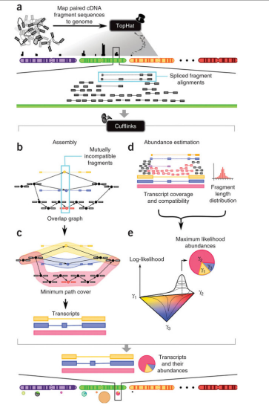
Estimating Transcript Abundance - Cufflinks
INPUT
.bam file (Accepted Hits)
Reference (.gtf)
Refseq, Ensembl, etc
Output (tabular form, excel)
FPKM quantifiable

Slide 22
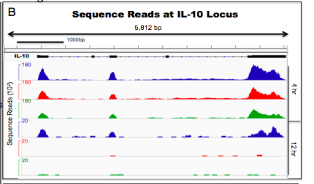
Visualizing Reads Across the Genome
Upload Files to UCSC Genome Browser
Convert .bam file to .bedgraph (using Galaxy)
Requires some coding
Size Limitations
Upload Files to Integrative Genome Viewer
Convert .bam file to .bedgraph (using Galaxy)
Upload directly
WT
IFNAR KO
IL-27R KO
WT
IFNAR KO
IL-27R KO

Slide 23
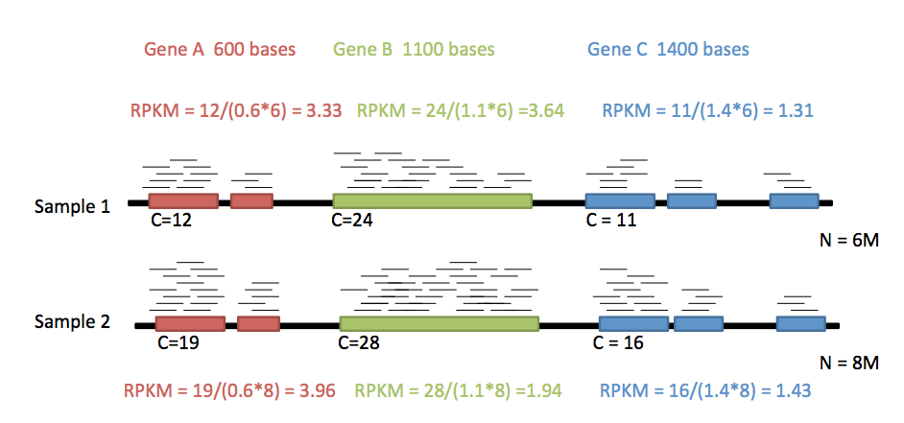
How do I quantify expression from RNA-seq?
RPKM: Reads per Kb million (Mortazavi et al. Nature Methods 2008)
Longer and more highly expressed transcripts are more likely be represented among RNA-seq reads
RPKM normalizes by transcript length and the total number of reads captured and mapped in the experiment
Sequencing depth can alter RPKM values

Slide 24
Differential Gene Expression Analysis
RPKM
-Can calculate Fold change
-Input sequence reads must be similar
-replicates not needed
-provides NO statistical test for differential gene expression
-useful for Cluster based classification of genes
http://www.bioinformatics.babraham.ac.uk/projects/seqmonk/Help/4%20Quantitation/4.3%20Pipelines/4.3.1%20RNA-Seq%20quantitation%20pipeline.html
CuffDiff (available on GALAXY)
-Input .bam file
-Can set statistical threshold (p<0.05 or whatever)
-replicates encouraged but not needed
-Input sequence reads can be somewhat dissimilar
-can provide differential splicing and promoter usage
DESeq
-Input .bam file
-Can set statistical threshold
-Input sequence reads can be somewhat dissimilar
-Must have replicates
-Not currently on Galaxy (must use Edge R)

Slide 25
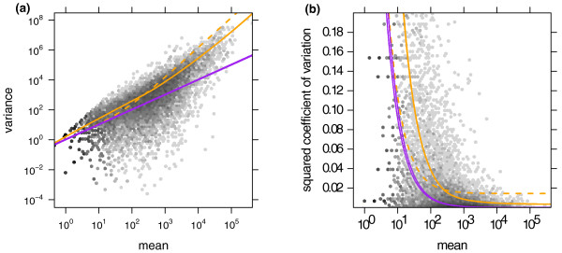
Differential Gene Expression Analysis: Sampling Variance
Consider a bag of balls with K number of red balls where K is much less than the total number of balls. You can sample n number of balls. P represents the proportion of red balls in your sample.
Estimate of the number of balls (u) = pn
K (the actual number of balls) follows a Poisson distribution and hence K varies around the expected value (u) with a standard deviation of 1/ sqroot (u)
Microarray data follows a Poisson distribution. However RNA seq does not.
In RNA Seq genes with high mean counts (either because they’re long or highly expressed) tend to show more variance (between samples) than genes with low mean counts. Thus this data fits a Negative Binomial Distribution
Poisson
Negative Binomial

Slide 26
Differential Gene Expression Analysis
CuffDiff: If you have two samples, cuffdiff tests, for each transcript whether there is evidence that the concentration of this transcript is not the same in the two samples
DESeq/EdgeR: If you have two different experimental conditions, with replicates for each condition, DESeq tests whether, for a given gene, the change in the expression strength between the two conditions is large as compared to the variation within each group.
You will get different answers with different tests

Slide 27
Resources
RNA-seq: technical variablity and sampling
McIntyre et al. BMC Genomics 2011 12:293
Statistical Design and Analysis of RNA Sequencing Data
Auer and Doerge. Genetics 2010 185(2): 405-416
Analyzing and minimizing PCR amplication bias in Illumina sequencing libraries
Aird et al. Genome Biology 2011 12:R18
ENCODE RNA-Seq guidelines
www.encodeproject.org/ENCODE/experiment_guidelines.html

Slide 28
Further Reading
RNA-seq: technical variablity and sampling
McIntyre et al. BMC Genomics 2011 12:293
Statistical Design and Analysis of RNA Sequencing Data
Auer and Doerge. Genetics 2010 185(2): 405-416
Analyzing and minimizing PCR amplication bias in Illumina sequencing libraries
Aird et al. Genome Biology 2011 12:R18
ENCODE RNA-Seq guidelines
www.encodeproject.org/ENCODE/experiment_guidelines.html

Slide 29
Further Reading
Bioinformatics for High Throughput Sequencing
Rodriguez-Ezpeleta et al. SpringerLink New York, NY Springer c2012
RNA sequencing: advances, challenges and opportunities
Ozsolak and Milos. Nature Reviews Genetics 12 87-98
Computational methods for transcriptome annotation and quantification using RNA-seq
Garber et al. Nature Methods 8, (2011)
Next-generation transcriptome assembly
Martin and Wang. Nature Reviews Genetics 12 671-682.
Differential gene and transcript expression analysis of RNA-seq experiments with TopHat and Cufflinks
Trapnell et al. Nature Protocols 2012
SEQanswers.com

